Slide 1
Application of machine learning tools for the analysis and prediction of wind and solar power generation
Tarek Ahmed 200108144
Md. Sabbir Hossain 200108148

Slide 2
Content
Research Goal
Introduction
Objective
Data Cleaning process
The Process of development
The Methodology
Power Generation Prediction
Power Generation
Forcast
Conclusion

Slide 3
Research Goal
Develop a Machine Learning Model for Wind and Solar Power Generation Prediction
Implement Time Horizon Forecasting for Wind and Solar Power Generation
Integration and Optimization

Slide 4

Introduction
Renewable sources harness nature for electricity, offering sustainable alternatives to fossil fuels, vital for combating climate change and energy security.

Slide 5
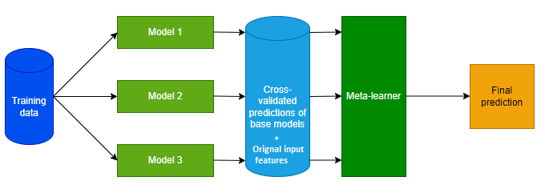
Introduction
Machine learning models analyze weather data to predict & forecast solar and wind power generation, aiding renewable energy integration and grid stability.

Slide 6
Objectives
ML algorithms predict renewable energy from meteorological data.
Forecast renewable energy at various time horizons.
Enhance grid stability, efficiency, cost savings with accurate renewable energy forecasts.

Slide 7
Methodology
Step 1
The statement of the problem
Step 2
The determination of objectives
Step 3
The process of reviewing the literature
Step 4
The formulation of methodology
Step 5
The process of Development
Step 6
The Reporting

Slide 8
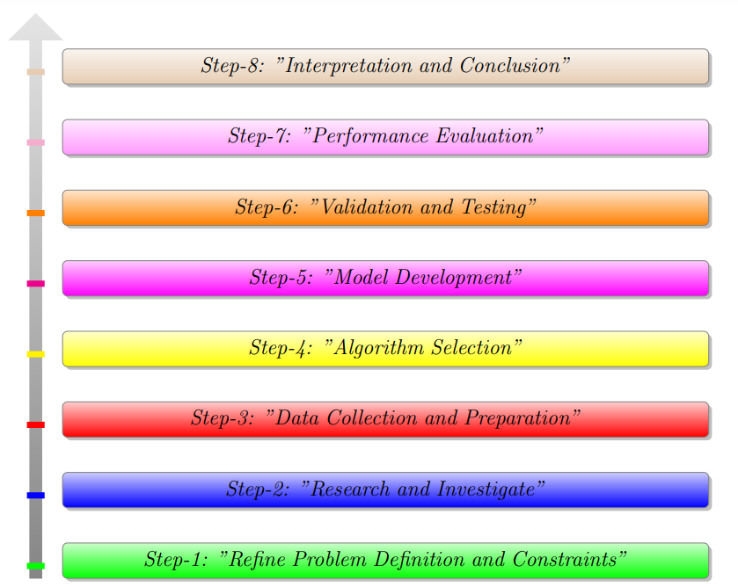
The Process of Development
Figure : Methodology of the thesis Project

Slide 9
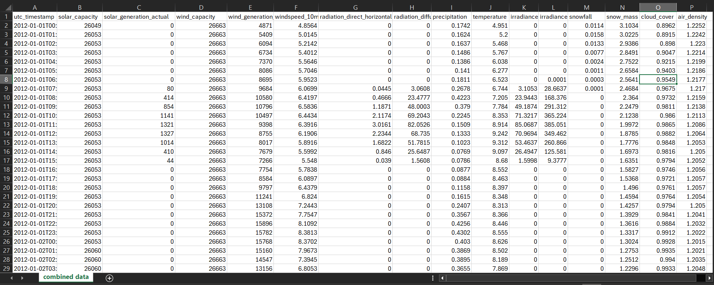
Data Collection and Preparation
Wind and solar power production data sourced from time-series records, paired with hourly weather data from Renewables.ninja using NASA MERRA-2.
Figure : Raw Data from NASA MERRA-2

Slide 10
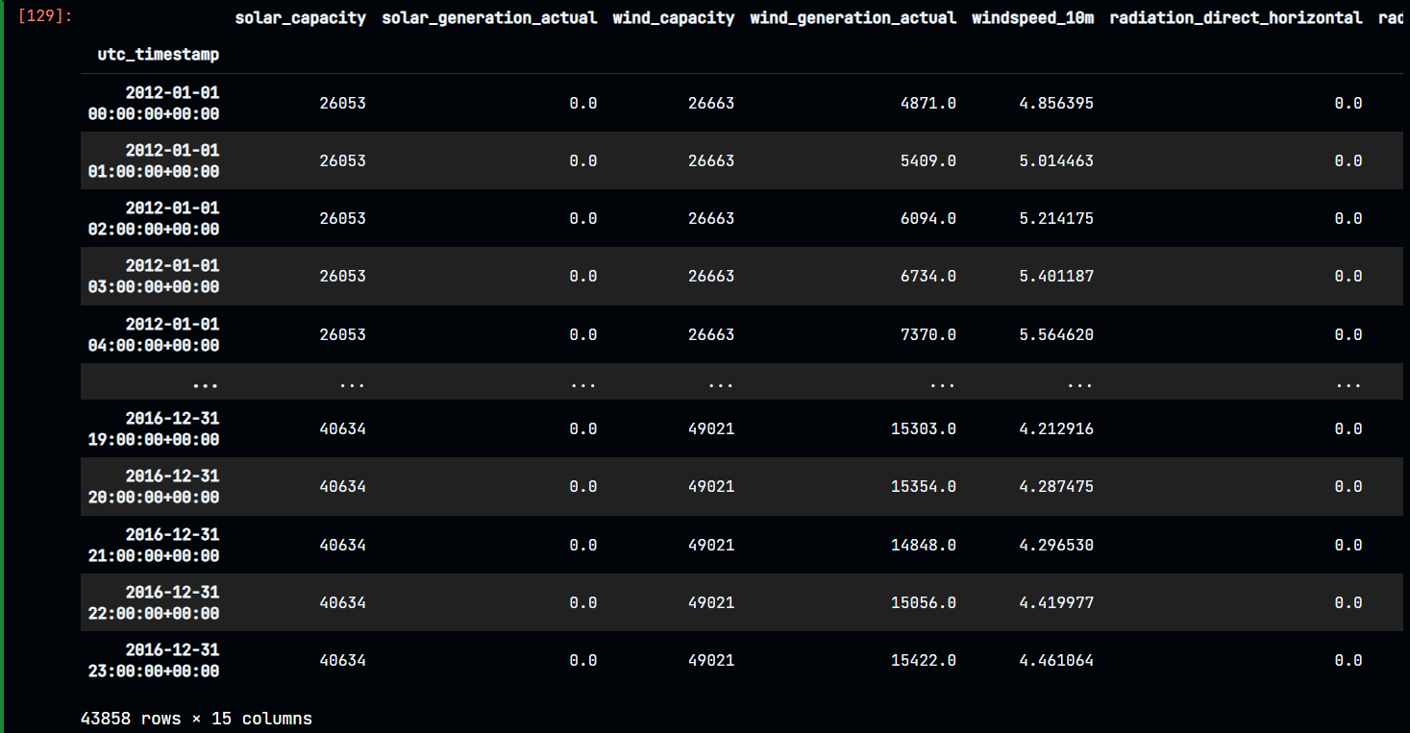
Data Cleaning Process
Here is the Final output of Data cleaning process where 43858 rows × 15 columns are present and no missing value.
Figure : Cleaned data without missing values

Slide 11
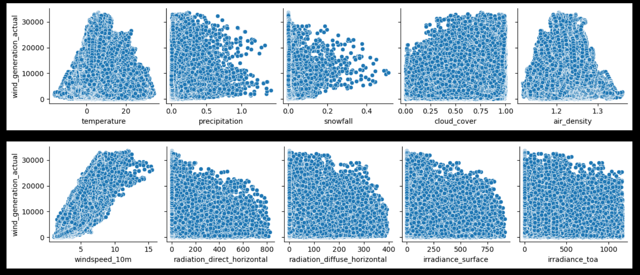
Data Cleaning Process
# Let's plot the generation of wind power (MWh) vs. weather data features
Figure : Wind power (MWh) vs. weather data features

Slide 12
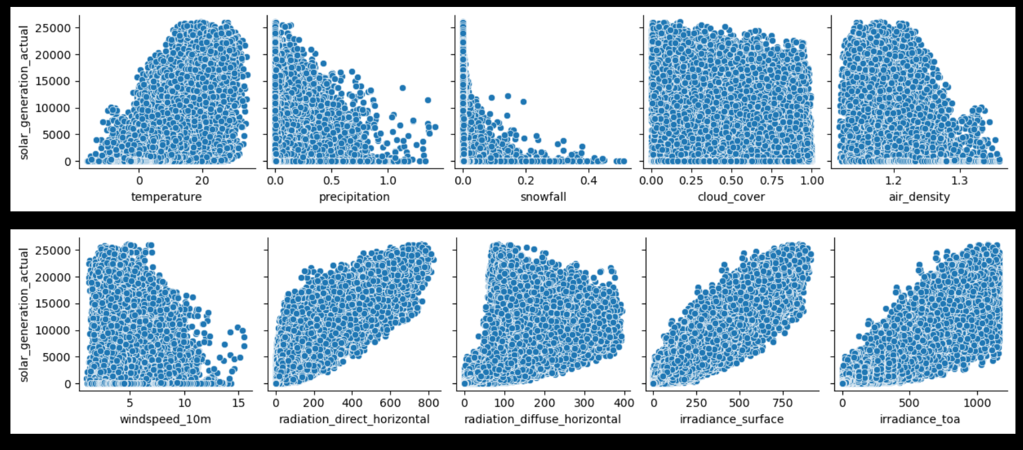
Data Cleaning Process
# Let's plot the generation of solar power (MWh) vs. weather data features
Figure : Solar power (MWh) vs. weather data features

Slide 13
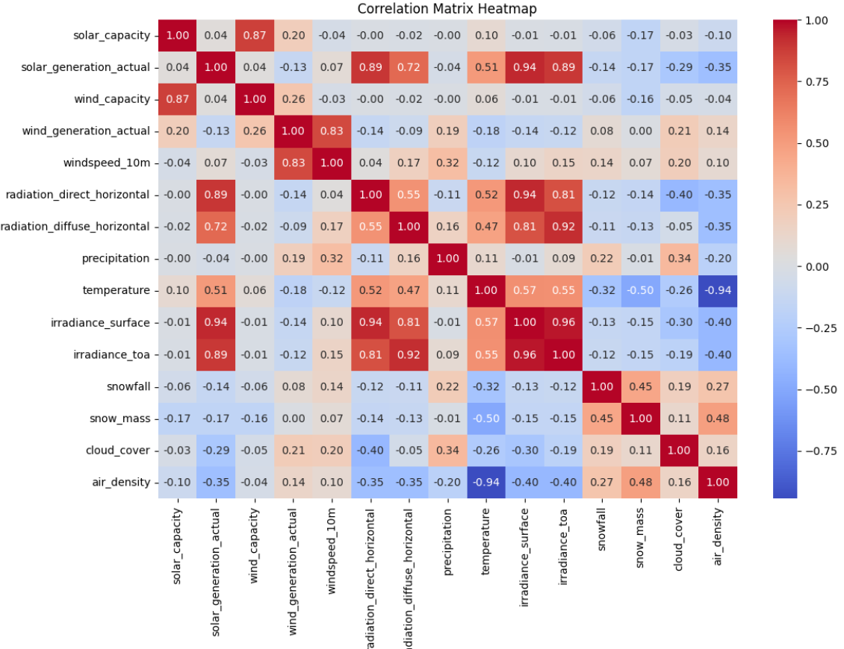
Data Cleaning Process
A correlation matrix heatmap visually represents the correlation between different variables in a dataset.
Figure : Correlation matrix heatmap

Slide 14
Algorithms
Linear Regression model
Decision Tree Regression model
Random Forest Regression model

Slide 15
Modeling
Model training
Cross-validation
Model testing
Model tuning

Slide 16
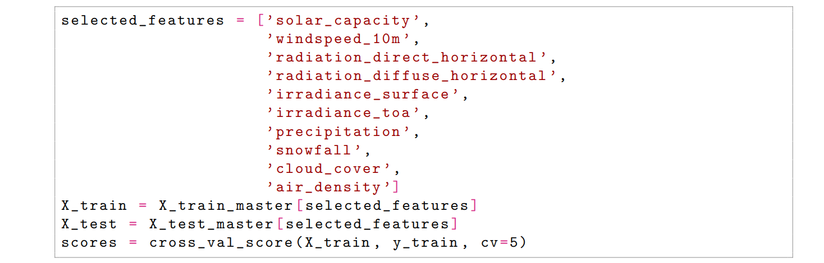
Solar Power Features

Slide 17
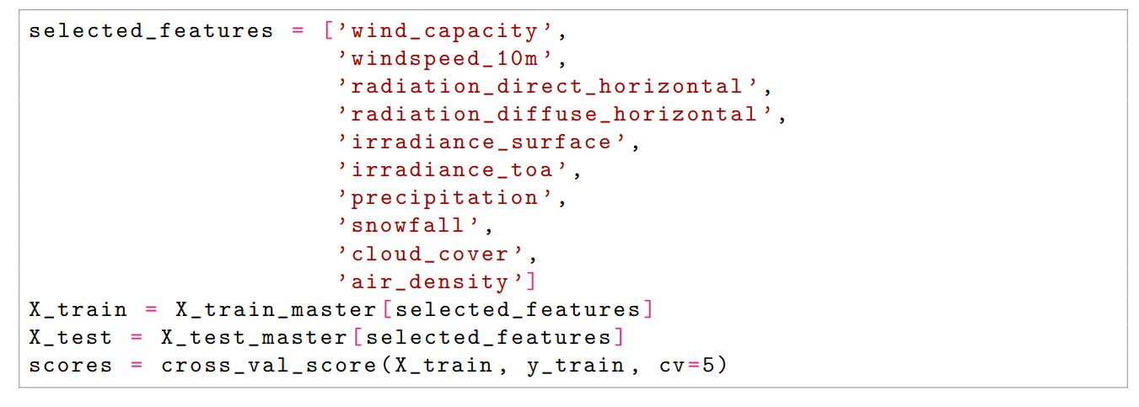
Wind Power Features

Slide 18
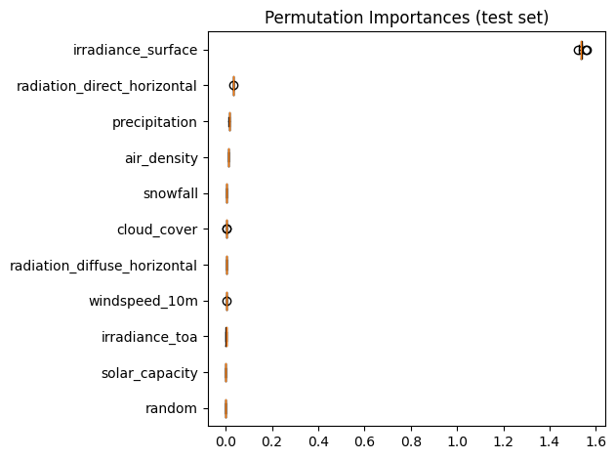
Best Feature for Solar Model

Slide 19
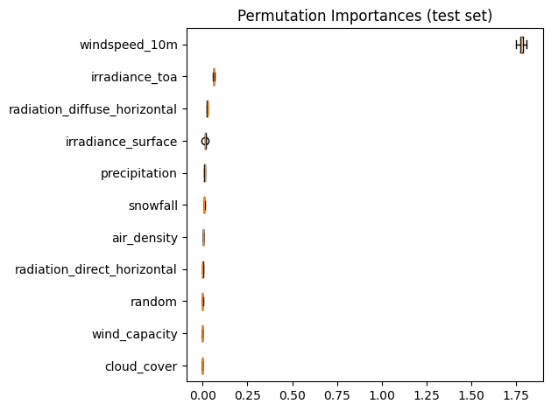
Best Feature for Wind Model

Slide 20
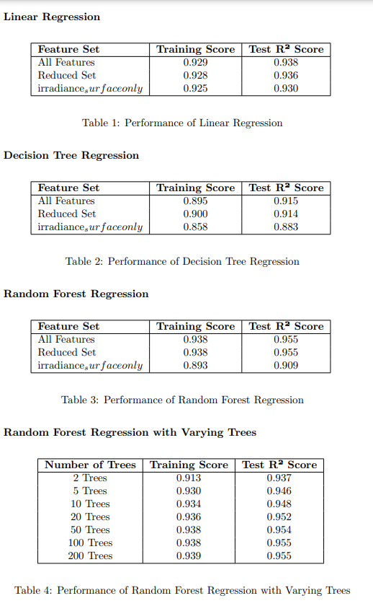
Solar Power Model Performance
Best Model: Random Forest with 100 trees.
Metrics:
Training Score: High
Test R²: 0.955
Improved performance with optimized features.

Slide 21
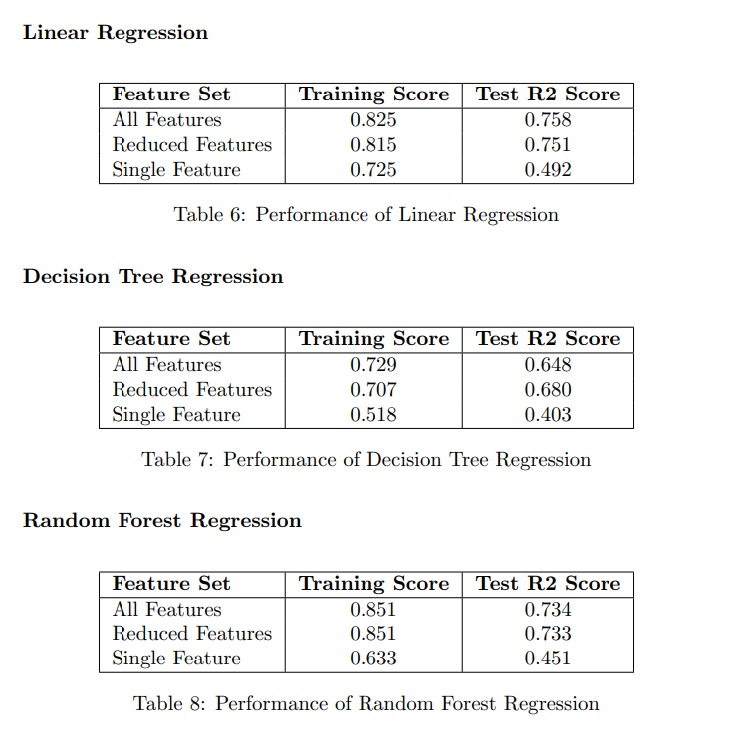
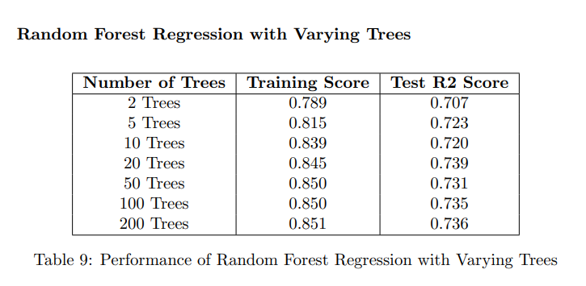
Wind Power Model Performance
Best Model: Random Forest with 20 trees.
Performance:
Training Score: High
Test R²: 0.736
Comparison across feature sets.

Slide 22
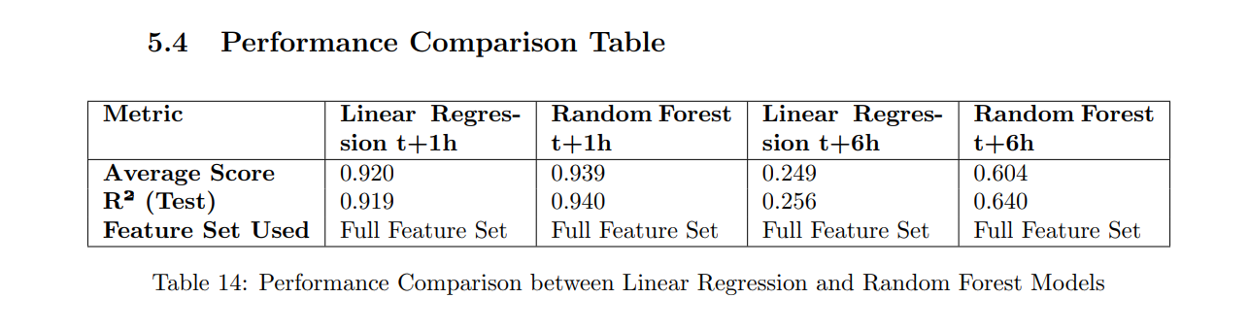
Forecasting Solar Power
Short-term predictions (t+1h):
Linear Regression: R² = 0.919
Random Forest: R² = 0.940
Long-term predictions (t+6h):
Linear Regression: R² = 0.256
Random Forest: R² = 0.640
Random Forest excels with full feature sets.

Slide 23
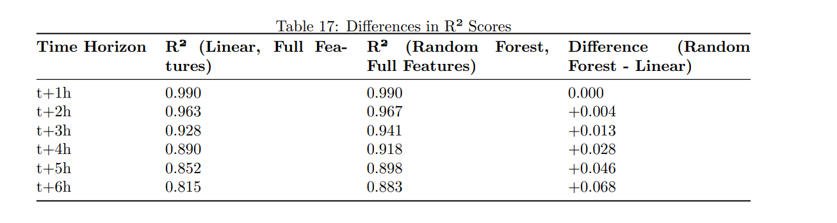
Forecasting Wind Power
Short-term predictions (t+1h):
Linear Regression: R² = 0.990
Random Forest: R² = 0.990
Long-term predictions (t+6h):
Linear Regression: R² = 0.815
Random Forest: R² = 0.883
Both models performs slightly well.

Slide 24
Challenges and Observations
Complexity vs. performance trade-offs in Random Forest.
Feature selection significantly impacts model accuracy.

Slide 25
Conclusion
Use Random Forest for both solar and wind energy predictions.
Ensure comprehensive feature selection for enhanced accuracy.
Use linear models for short-term forecasts if simplicity is preferred.
Ensemble methods (Random Forest) excel in renewable energy forecasting.

Slide 26
THANK YOU
PLEASE STATE YOUR VALUABLE COMMENTS AND QUESTIONS

